Slide 2
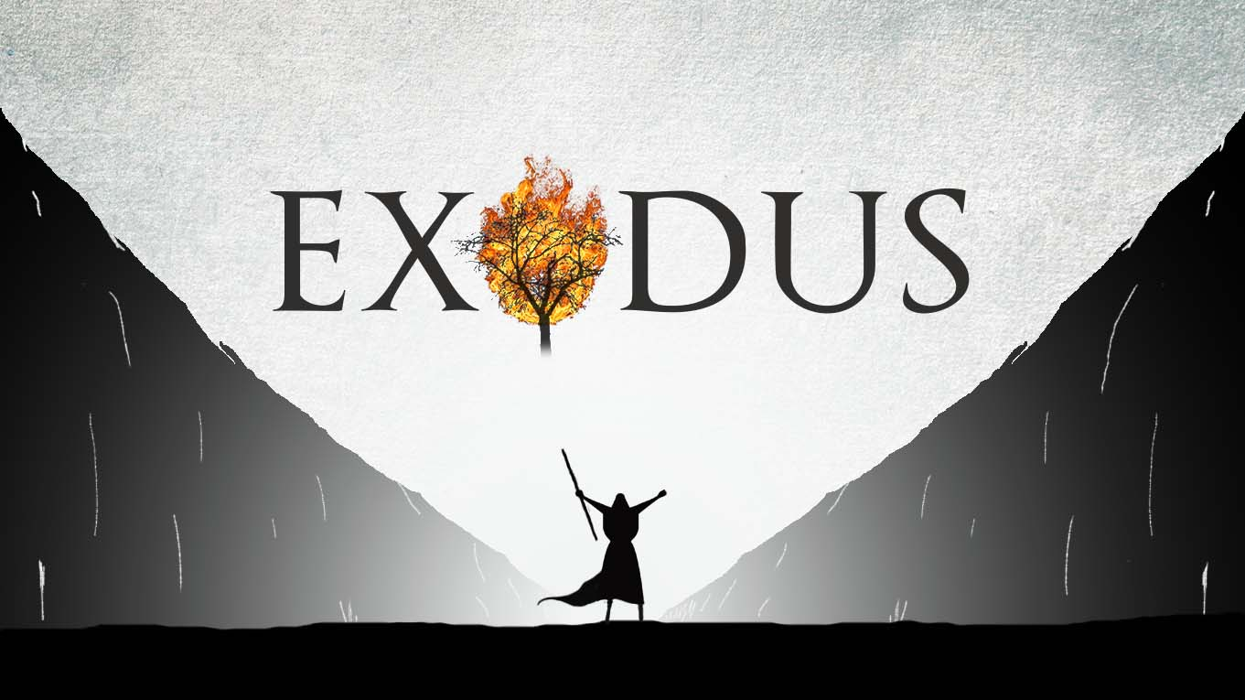
WHO IS LIKE YOU?

