Slide 1
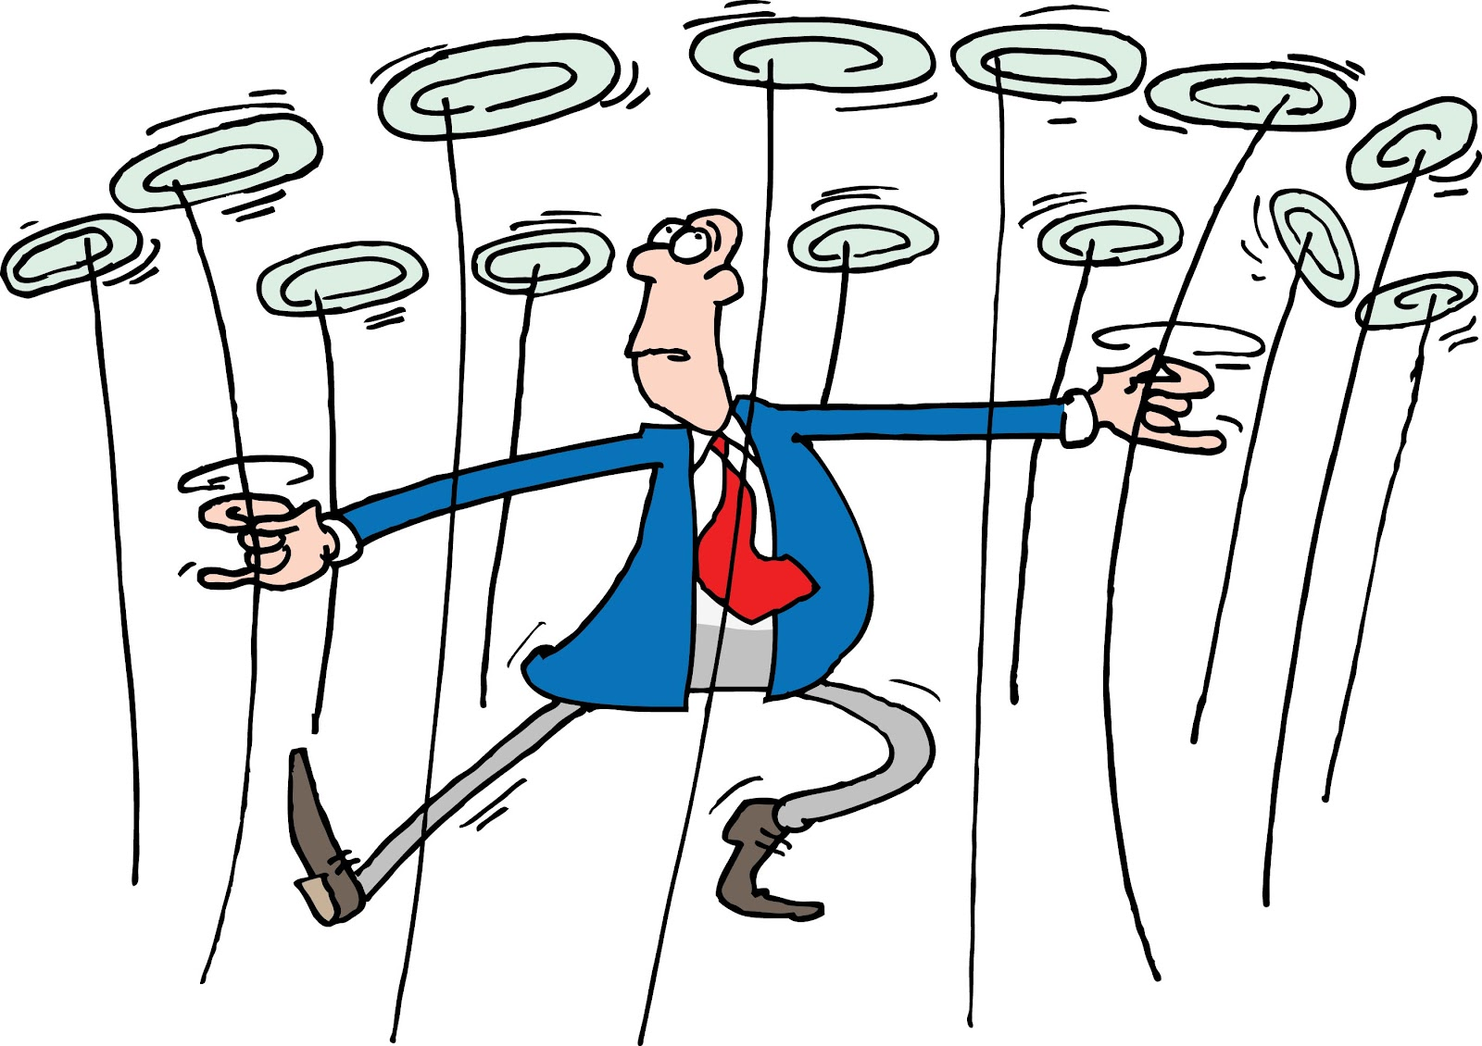

Slide 2
Distinctively Doing
A distinctive definition
A distinctive foundation
A distinctive motivation
A distinctive power

Slide 3
Distinctively Doing
Productivity is effectively using the resources God has invested in me to serve him and do good to others.

Slide 4
Distinctively Doing
A distinctive definition
A distinctive foundation
A distinctive motivation
A distinctive power

Slide 5
How to be ineffective
Laziness

Slide 6
How to be ineffective
How long will you lie there, you sluggard? When will you get up from your sleep?
Proverbs 6:9

Slide 7
How to be ineffective
The craving of a sluggard will be the death of him, because his hands refuse to work.
Proverbs 21:25

Slide 8
How to be ineffective
Laziness
Busyness

Slide 9
How to be ineffective
Laziness
Busyness
Idolatry

Slide 10
How to be ineffective
Laziness
Busyness
Idolatry
Comparison

Slide 11
How to be ineffective
So whether you eat or drink or whatever you do, do it all for the glory of God.
1 Corinthians 10:31

Slide 12
How to be ineffective
Laziness
Busyness
Idolatry
Comparison
Self-dependence

Slide 13
How to be effective
Define your goals

Slide 14
How to be effective
For you were once darkness, but now you are light in the Lord. Live as children of light (for the fruit of the light consists in all goodness, righteousness and truth) and find out what pleases the Lord.
Ephesians 5:8-10

Slide 15
How to be effective
Define your goals
Look forwards

Slide 16
How to be effective
The plans of the diligent lead to profit as surely as haste leads to poverty.
Proverbs 21:5

Slide 17
How to be effective
In their hearts humans plan their course, but the Lord establishes their steps.
Proverbs 16:9

Slide 18
How to be effective
Now listen, you who say, ‘Today or tomorrow we will go to this or that city, spend a year there, carry on business and make money.’ Why, you do not even know what will happen tomorrow. What is your life? You are a mist that appears for a little while and then vanishes. Instead, you ought to say, ‘If it is the Lord’s will, we will live and do this or that.’
James 4:13-15

Slide 19
How to be effective
Define your goals
Look forwards
Look backwards

Slide 20
How to be effective
Define your goals
Look forwards
Look backwards
Take care of yourself

