Slide 1
A Distinctive Definition
Business productivity
Product, profit
Capital, labour, materials

Slide 2
A Distinctive Definition
People want to get stuff done more efficiently to be better, faster, smarter, richer, or just to free up more time for things they enjoy ... Personal productivity is ultimately about achieving goals.

Slide 3
A Distinctive Definition
People want to get stuff done more efficiently to be better, faster, smarter, richer, or just to free up more time for things they enjoy ... Personal productivity is ultimately about achieving goals.
Personal productivity
Better me
Me

Slide 4
A Distinctive Definition
Productivity is effectively using the resources God has invested in me to serve him and do good to others.

Slide 5
A Distinctive Definition
Productivity is effectively using the resources God has invested in me to serve him and do good to others.
Personal productivity
Better me
Me

Slide 6
A Distinctive Definition
Productivity is effectively using the resources God has invested in me to serve him and do good to others.
Personal productivity
Better me
God-given resources

Slide 7
A Distinctive Definition
Productivity is effectively using the resources God has invested in me to serve him and do good to others.
Personal productivity
Serving God
God-given resources

Slide 8
A Distinctive Definition
Productivity is effectively using the resources God has invested in me to serve him and do good to others.
Personal productivity
Serving God, doing good
God-given resources

Slide 9
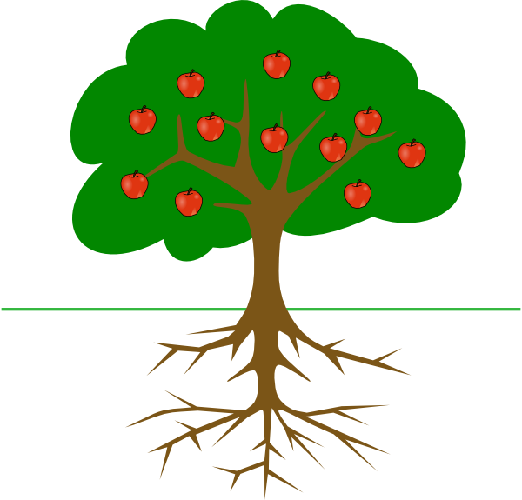
A Distinctive Foundation
Productivity
Not productivity

Slide 10
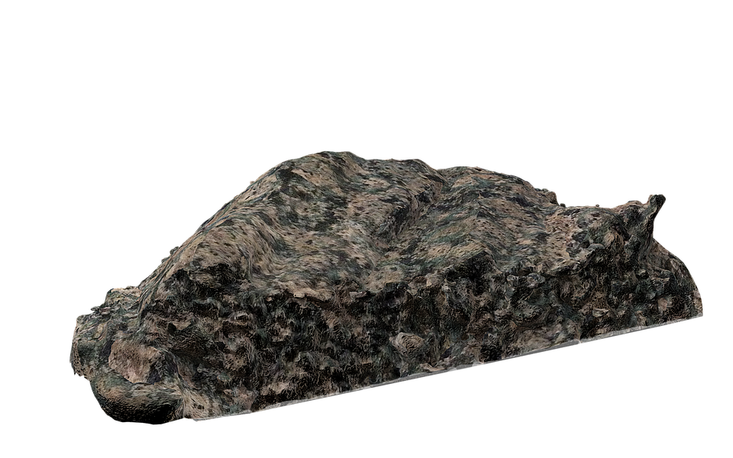
A Distinctive Foundation
To do no harm is the praise of a stone, not a man.

Slide 11
A Distinctive Motivation

Slide 12
A Distinctive Motivation
Responsibility

Slide 13
A Distinctive Motivation
Responsibility
Readiness

Slide 14
A Distinctive Motivation
Responsibility
Readiness
Reward

Slide 15
A Distinctive Power

