Slide 1
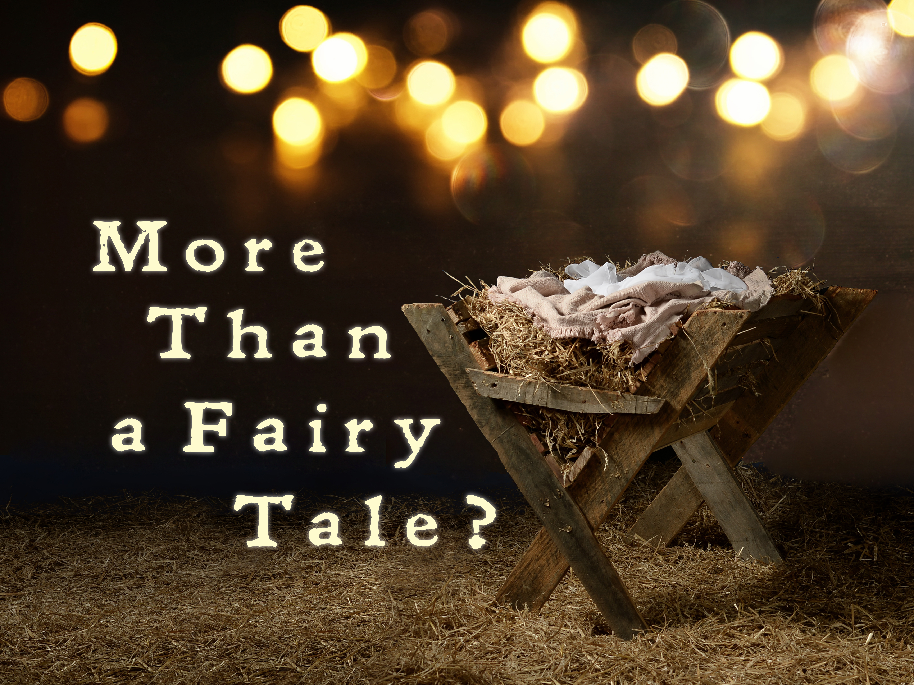

Slide 2
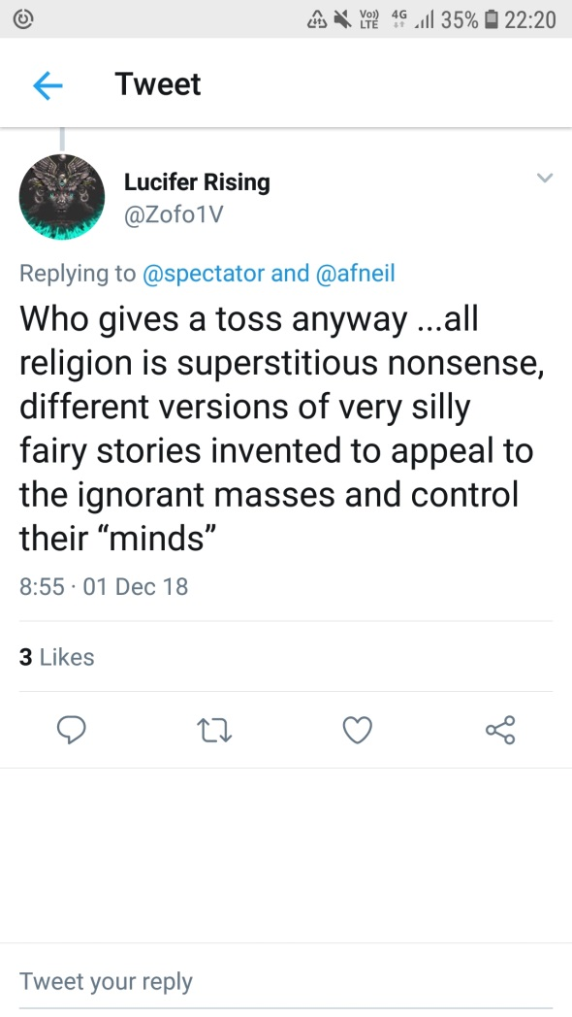
Once upon a Time… Luke 1:1-4

Slide 3
Once upon a Time… Luke 1:1-4
Is it True?
Is it Good?
Is it Beautiful?

Slide 4
Once upon a Time… Luke 1:1-4
Many have undertaken to draw up an account of the things that have been fulfilled among us, just as they were handed down to us by those who from the first were eyewitnesses and servants of the word. With this in mind, since I myself have carefully investigated everything from the beginning, I too decided to write an orderly account for you, most excellent Theophilus, so that you may know the certainty of the things you have been taught.

Slide 5
Once upon a Time… Luke 1:1-4
Our dear friend Luke, the doctor, and Demas send greetings.
- Colossians 4v14
Only Luke is with me. Get Mark and bring him with you, because he is helpful to me in my ministry
– 2 Timothy 4v11
Epaphras, my fellow prisoner in Christ Jesus, sends you greetings. ²⁴ And so do Mark, Aristarchus, Demas and Luke, my fellow workers
– Philemon 1v24

Slide 6
Once upon a Time… Luke 1:1-4
Many have undertaken to draw up an account of the things that have been fulfilled among us, just as they were handed down to us by those who from the first were eyewitnesses and servants of the word. With this in mind, since I myself have carefully investigated everything from the beginning, I too decided to write an orderly account for you, most excellent Theophilus, so that you may know the certainty of the things you have been taught.

Slide 7
Once upon a Time… Luke 1:1-4
For we did not follow cleverly devised stories when we told you about the coming of our Lord Jesus Christ in power, but we were eye-witnesses of his majesty. ¹⁷ He received honour and glory from God the Father when the voice came to him from the Majestic Glory, saying, ‘This is my Son, whom I love; with him I am well pleased.’^{[b]} ¹⁸ We ourselves heard this voice that came from heaven when we were with him on the sacred mountain.
- 2 Peter 1v16-18

Slide 8
Once upon a Time… Luke 1:1-4
That which was from the beginning, which we have heard, which we have seen with our eyes, which we have looked at and our hands have touched – this we proclaim concerning the Word of life. ² The life appeared; we have seen it and testify to it, and we proclaim to you the eternal life, which was with the Father and has appeared to us. ³ We proclaim to you what we have seen and heard, so that you also may have fellowship with us.
- 1 John 1v1-3

Slide 9
Once upon a Time… Luke 1:1-4
1v5 In the time of Herod king of Judea there was a priest named Zechariah,
2v1-2 In those days Caesar Augustus issued a decree that a census should be taken of the entire Roman world. ² (This was the first census that took place while^{[a]} Quirinius was governor of Syria.)
3v1-2 In the fifteenth year of the reign of Tiberius Caesar – when Pontius Pilate was governor of Judea, Herod tetrarch of Galilee, his brother Philip tetrarch of Iturea and Traconitis, and Lysanias tetrarch of Abilene – ² during the high-priesthood of Annas and Caiaphas, the word of God came to John son of Zechariah in the wilderness.

Slide 10
Once upon a Time… Luke 1:1-4
13v1-4 Now there were some present at that time who told Jesus about the Galileans whose blood Pilate had mixed with their sacrifices. ² Jesus answered, ‘Do you think that these Galileans were worse sinners than all the other Galileans because they suffered this way? ³ I tell you, no! But unless you repent, you too will all perish. ⁴ Or those eighteen who died when the tower in Siloam fell on them – do you think they were more guilty than all the others living in Jerusalem?

Slide 11
Once upon a Time… Luke 1:1-4
“The modern mind argues that Jesus is just one more attempt at explaining what we merely wish were true. While I know where such a statement is usually going (and disagree), perhaps it is also right. There are elements in myth that we do want to believe—namely, that the gods do reveal themselves to us, that heavenly mysteries can be known on some real level, and that life really is saturated with purpose and meaning.”

Slide 12
Once upon a Time… Luke 1:1-4
“What humanity has longed for most has happened: "The Word became flesh and made his dwelling among us. And we have seen his glory, the glory of the one and only, who came from the Father, full of grace and truth." Reaching into time and touching real history, Jesus came to us; he came to the Cross. But it did not master him.”

Slide 13
Once upon a Time… Luke 1:1-4
““the story of Christ is simply a true myth: a myth working on us in the same way as the others, but with this tremendous difference that it really happened.”

