Slide 1
Foundations
A New Year Look at our Values

Slide 2
What is the scariest word you can think of?

Slide 3
Evangelism

Slide 4
Evangel = gospel

Slide 5
Evangel = gospel
Evangelical = gospel believing
Evangelism = gospel sharing

Slide 6
We are committed to sharing what we believe with others

Slide 7
Step 1: Give the right motivation

Slide 8
Step 1: Give the right motivation
Step 2: Set a clear goal

Slide 9
Step 1: Give the right motivation
Step 2: Set a clear goal
Step 3: Provide the necessary resources

Slide 10
Step 1: Give the right motivation
Step 2: Set a clear goal
Step 3: Provide the necessary resources
Step 4: Encourage team work

Slide 11
The right motivation

Slide 12
“Motivation is the single most important factor in any sort of success”
Sir Edmund Hillary

Slide 13
Cold outside
therefore
put on a coat

Slide 14
Christ has been given authority
therefore
go and make disciples

Slide 15
?
Christ has been given authority
therefore
go and make disciples

Slide 16
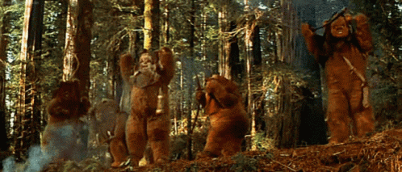

Slide 18
A clear goal

Slide 20
Disciples of Christ will:
Be from all nations

Slide 21
Disciples of Christ will:
Be from all nations
Come by grace

Slide 22
Disciples of Christ will:
Be from all nations
Come by grace
Be obedient

Slide 23
The necessary resources

Slide 24
Team work

Slide 25
Foundations
A New Year Look at our Values

