Slide 2
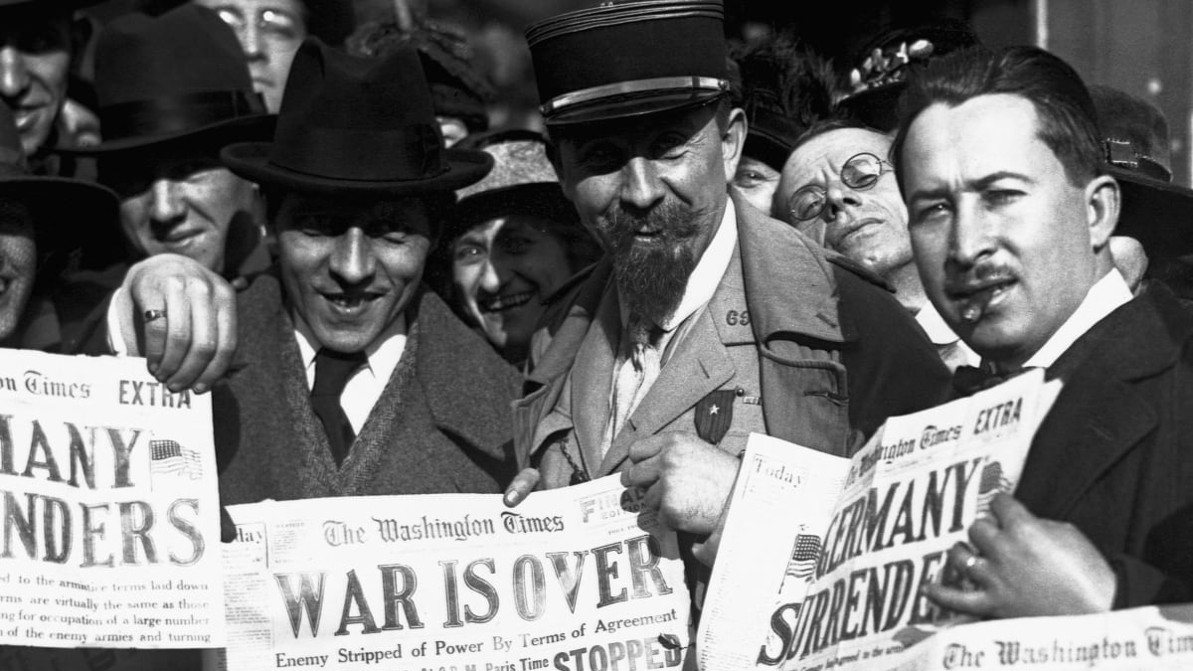
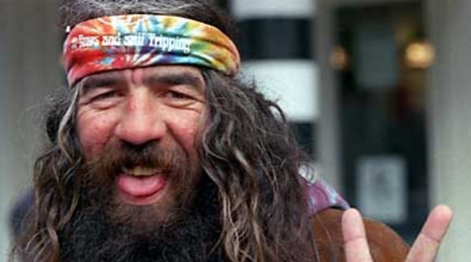

Slide 3
Peace
The pursuit of peace
The world’s answer is escape

Slide 4
VIDEO

Slide 5
Peace
The pursuit of peace
The world’s answer is escape
The Prince of Peace
Pays the price of peace

Slide 6
SECOND READING: Philippians 4:4-13

Slide 7
Peace
The pursuit of peace
The world’s answer is escape
The Prince of Peace
Pays the price of peace
The practice of peace
Pray with thanksgiving

Slide 8
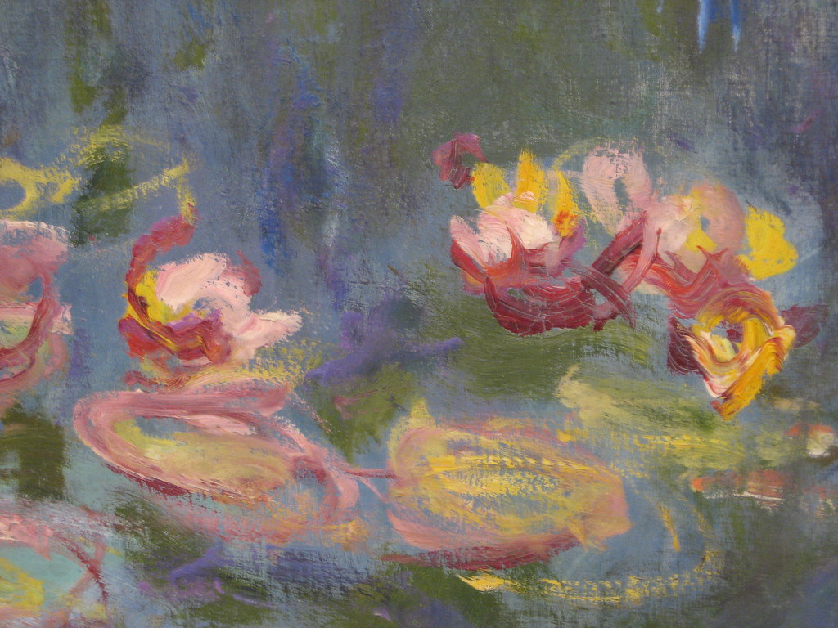

Slide 11
Peace
The pursuit of peace
The world’s answer is escape
The Prince of Peace
Pays the price of peace
The practice of peace
Pray with thanksgiving
Think…about doctrine
• Think…about Christ

