Slide 2
Listening to the King: Matthew 13v1-23

Slide 3
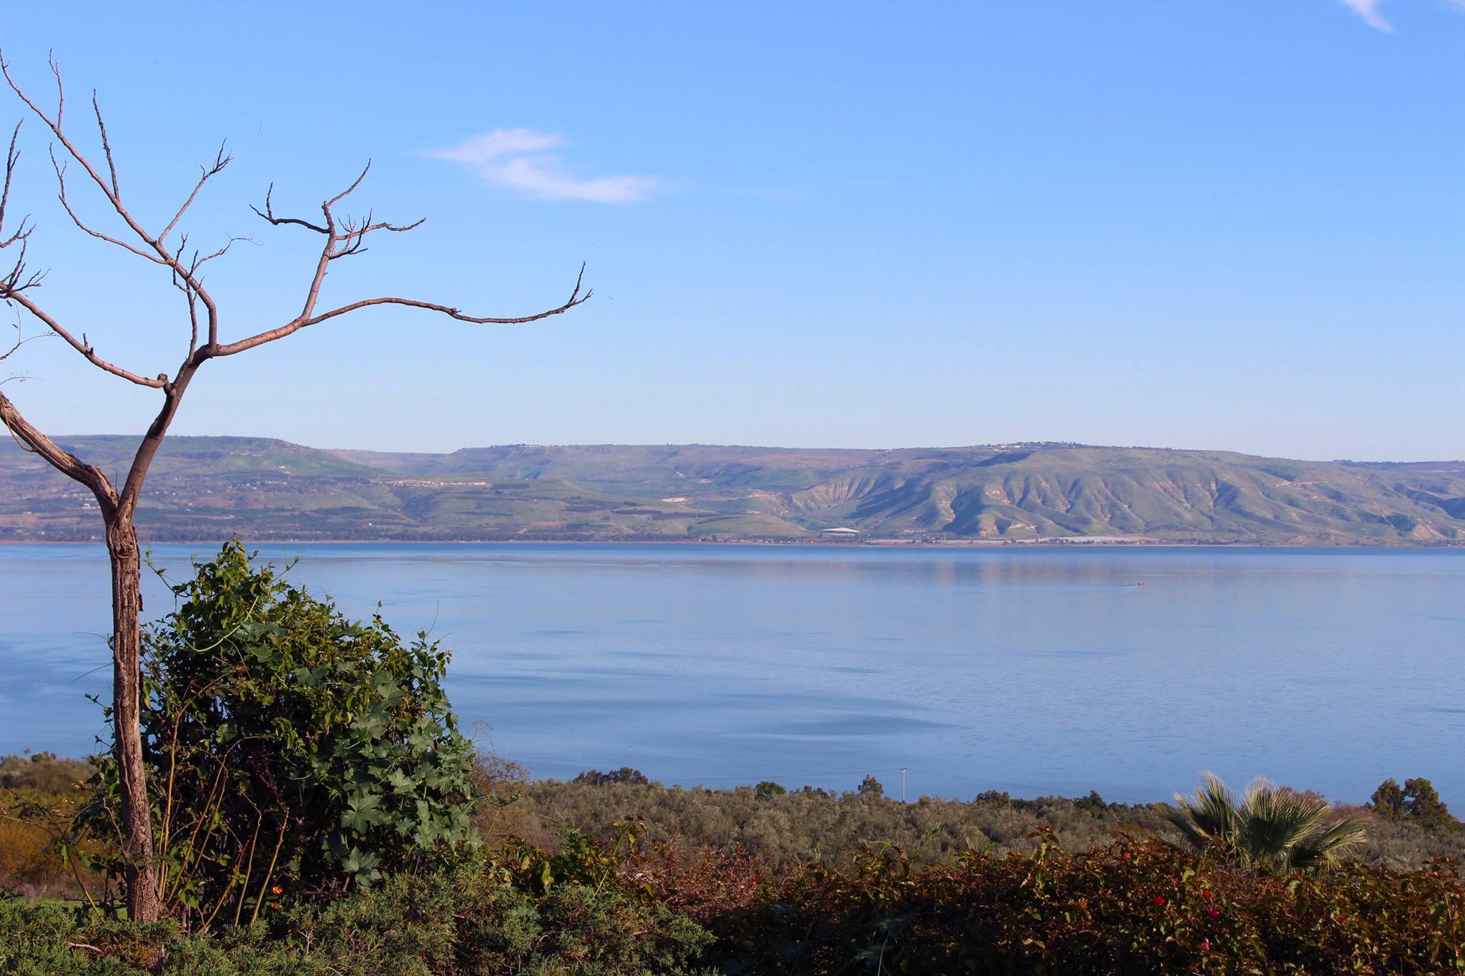
Setting the Scene

Slide 4
Setting the Scene

Slide 5
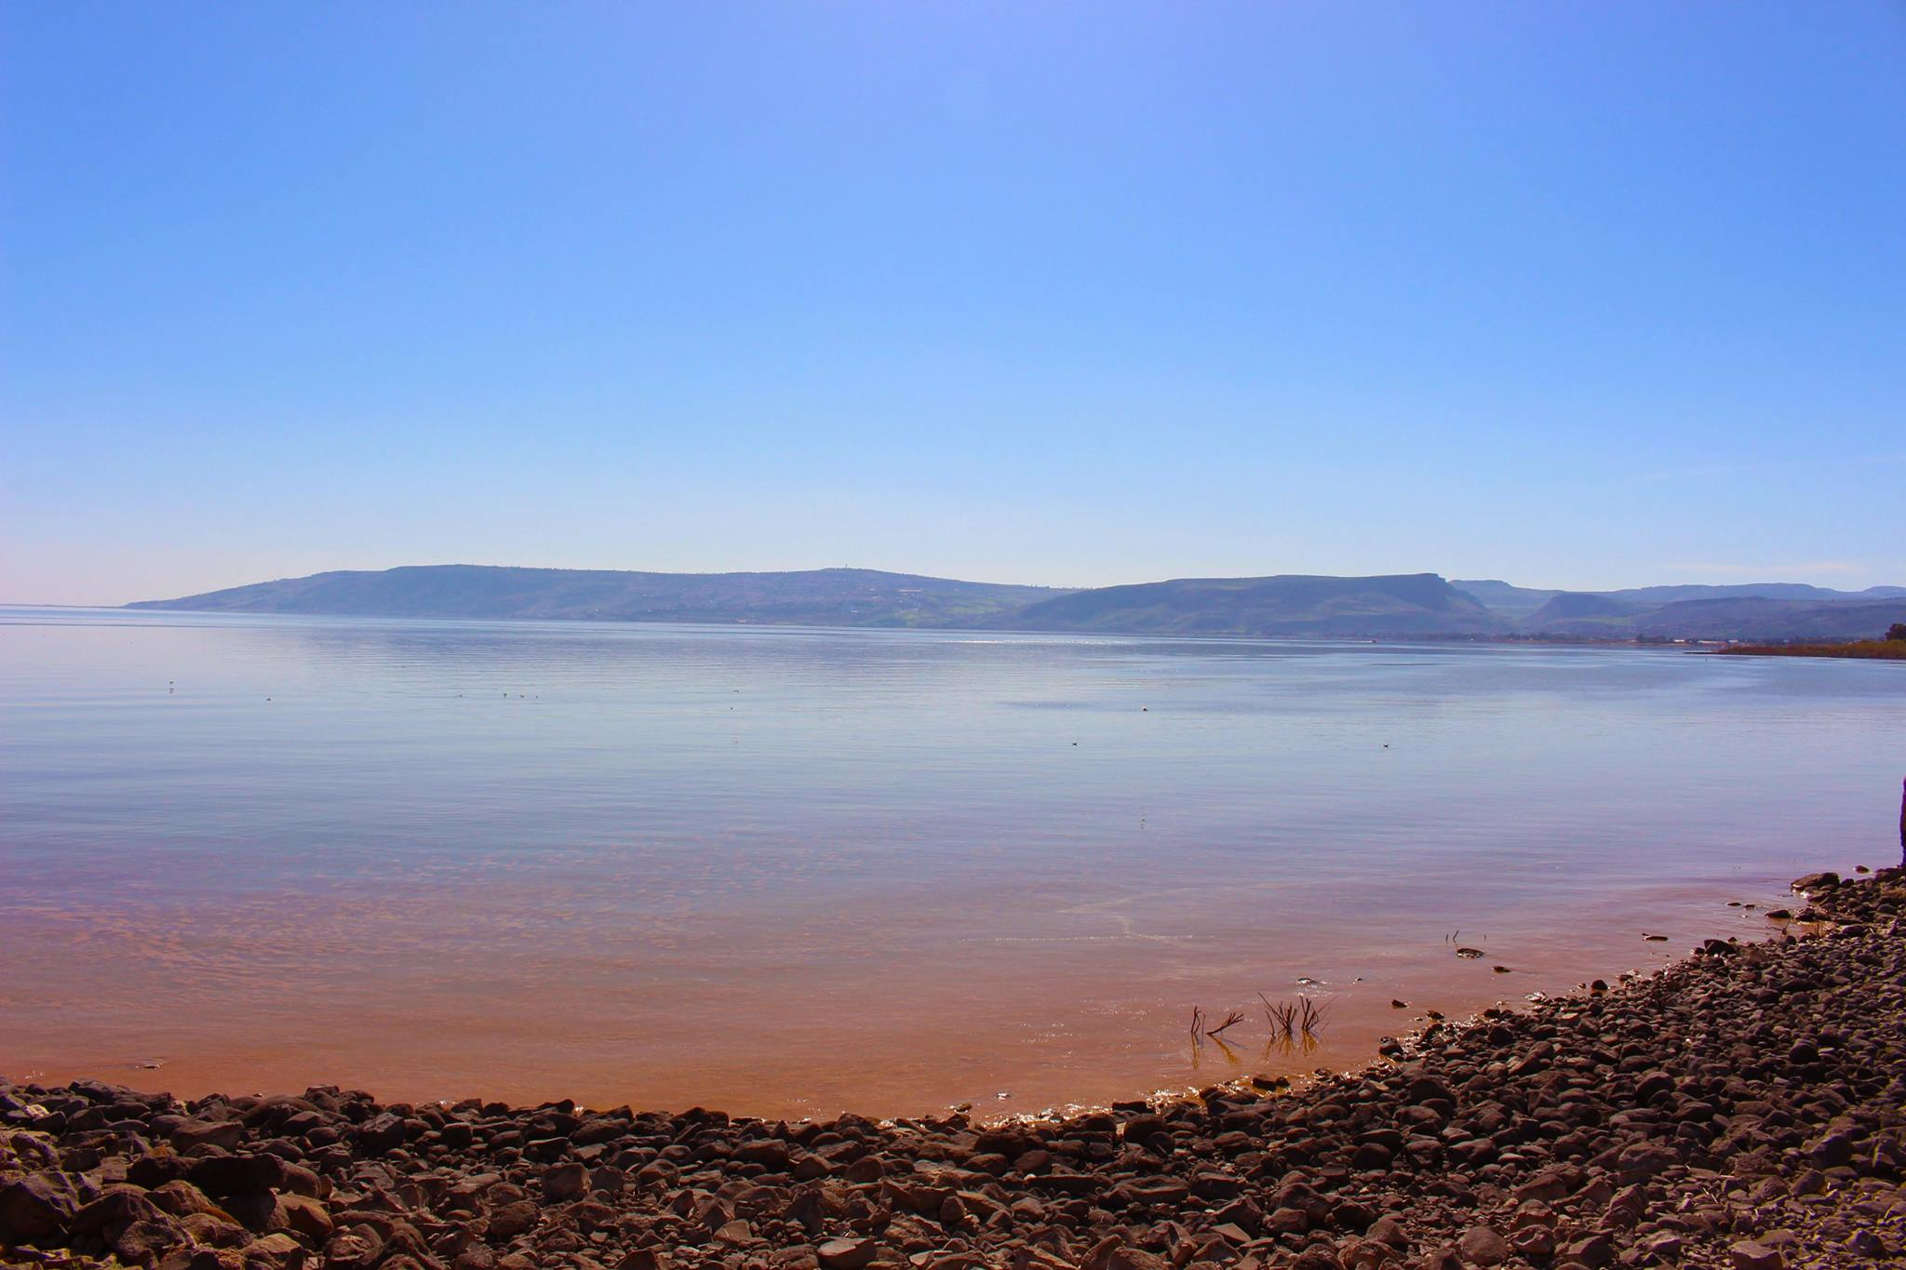
Setting the Scene

Slide 6
Parables: A 2-Way Street

Slide 7
Parables: A 2-Way Street
Then I said, ‘For how long, Lord?’
And he answered:
‘Until the cities lie ruined and without inhabitant, until the houses are left deserted and the fields ruined and ravaged, ¹² until the Lord has sent everyone far away and the land is utterly forsaken. ¹³ And though a tenth remains in the land, it will again be laid waste. But as the terebinth and oak leave stumps when they are cut down, so the holy seed will be the stump in the land.’

Slide 8
Are You Listening to the King?
Not all will accept the message
The Kingdom will grow
Are you listening to the King?

