Slide 2
Real Wisdom / Scam Wisdom
Notes:
Title

Slide 3
Notes:
Title

Slide 4
Real Wisdom / Scam Wisdom:
Notes:
George C. Parker

Slide 5
Real Wisdom / Scam Wisdom:
¹³ Who is wise and understanding among you? Let them show it by their good life, by deeds done in the humility that comes from wisdom. ¹⁴ But if you harbor bitter envy and selfish ambition in your hearts, do not boast about it or deny the truth. ¹⁵ Such “wisdom” does not come down from heaven but is earthly, unspiritual, demonic. ¹⁶ For where you have envy and selfish ambition, there you find disorder and every evil practice.
¹⁷ But the wisdom that comes from heaven is first of all pure; then peace-loving, considerate, submissive, full of mercy and good fruit, impartial and sincere. ¹⁸ Peacemakers who sow in peace reap a harvest of righteousness.
James 3:13-18

Slide 6
Real Wisdom / Scam Wisdom:
Scam Wisdom messes with reality so don’t fall for it

Slide 7
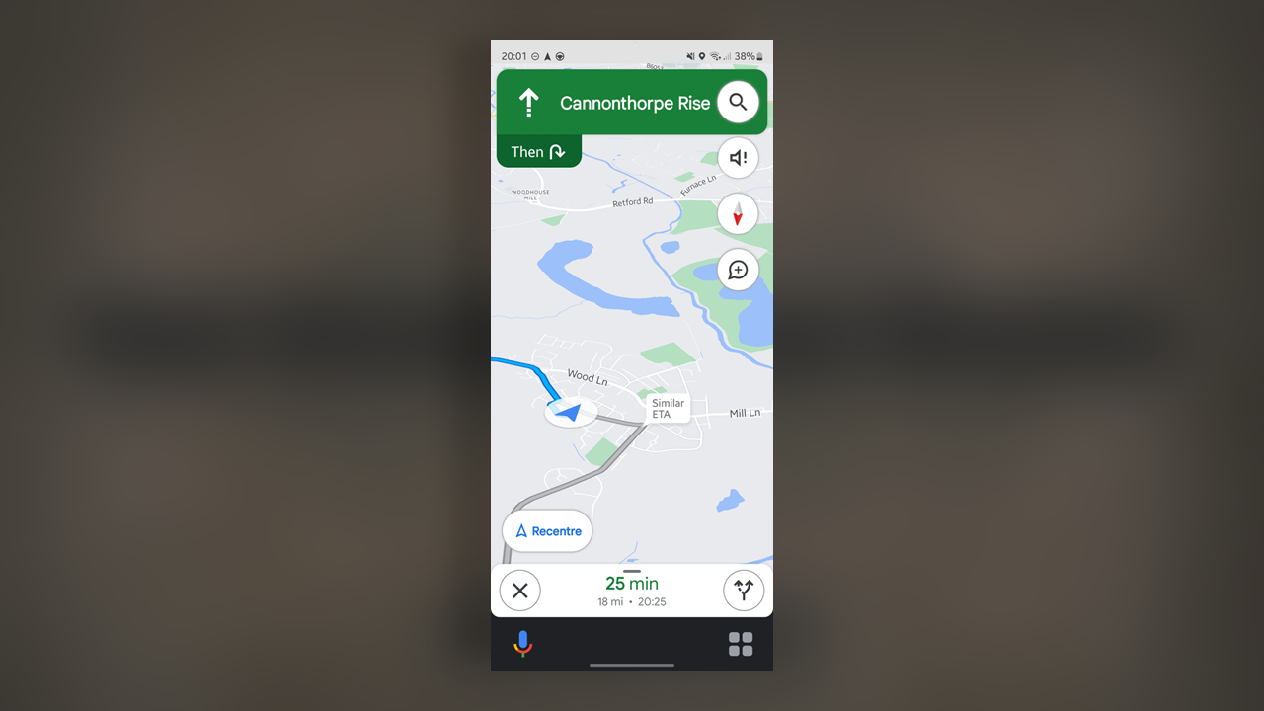
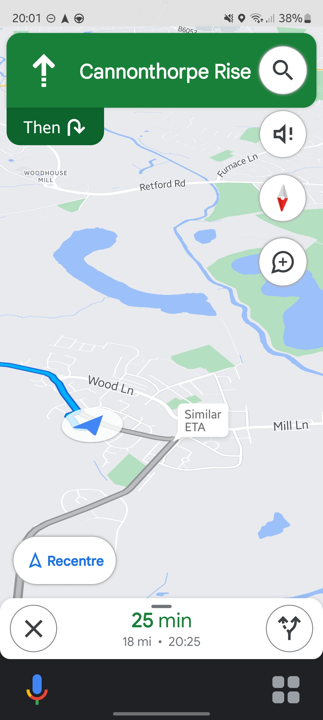
Notes:
Title

Slide 8
Notes:
Title

Slide 9
Real Wisdom / Scam Wisdom:
Scam Wisdom messes with reality so don’t fall for it
Notes:
Title

Slide 10
Real Wisdom / Scam Wisdom:
The fear of the Lord is the beginning of wisdom, and knowledge of the Holy One is understanding.
Proverbs 9:10
Notes:
Title

Slide 11
Real Wisdom / Scam Wisdom:
Scam Wisdom messes with reality so don’t fall for it
Notes:
Title

Slide 12
Real Wisdom / Scam Wisdom:
¹³ Who is wise and understanding among you? Let them show it by their good life, by deeds done in the humility that comes from wisdom. ¹⁴ But if you harbor bitter envy and selfish ambition in your hearts, do not boast about it or deny the truth. ¹⁵ Such “wisdom” does not come down from heaven but is earthly, unspiritual, demonic. ¹⁶ For where you have envy and selfish ambition, there you find disorder and every evil practice.
¹⁷ But the wisdom that comes from heaven is first of all pure; then peace-loving, considerate, submissive, full of mercy and good fruit, impartial and sincere. ¹⁸ Peacemakers who sow in peace reap a harvest of righteousness.

Slide 13
Real Wisdom / Scam Wisdom:
Scam Wisdom messes with reality so don’t fall for it
Real Wisdom™ is God’s wisdom so be Peacemakers
Notes:
Title

Slide 14
Notes:
Title

Slide 15
Real Wisdom / Scam Wisdom:
Scam Wisdom messes with reality so don’t fall for it
Real Wisdom™ is God’s wisdom so be Peacemakers
Notes:
Title

Slide 16
Real Wisdom / Scam Wisdom:
Now if any of you lacks wisdom, he should ask God, who gives generously to all without finding fault, and it will be given to him.
James 1:5
Notes:
Title

